Slide 1
Lecture 3: Perfect cipher, stream cipher, PRG, semantic security
Introduction to Computer Security

Slide 2
Acknowledgements and Reading
These slides are adapted from lecture slides by…
Lawrie Brown
Dan Boneh
and others
Reading: Chapter 7

Slide 3
The One Time Pad

Slide 4
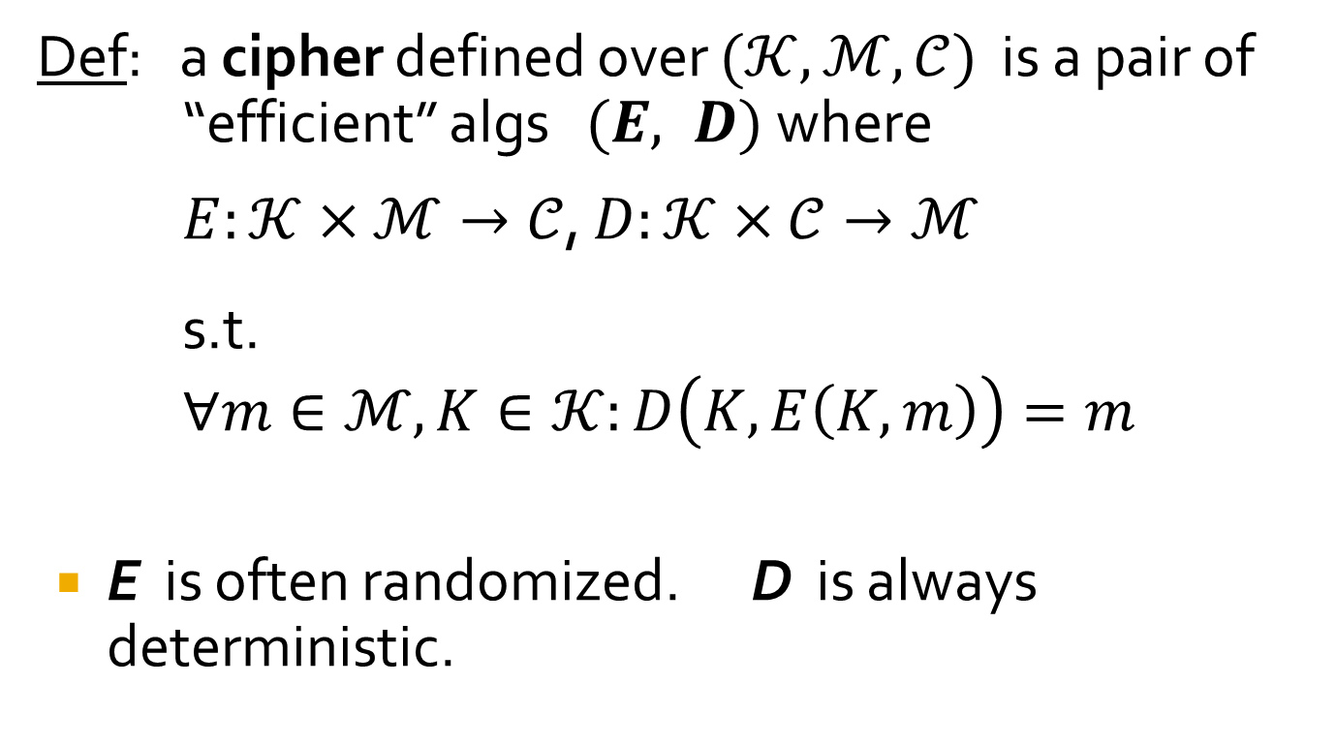
Symmetric Ciphers: definition
Def: a cipher defined over $(𝒦,ℳ,𝒞)$ is a pair of
“efficient” algs $(E, D)$ where
$E:𝒦×ℳ→𝒞$, $D:𝒦×𝒞→ℳ$ s.t.
$∀m∈ℳ,K∈𝒦:D\left(K,E\left(K,m\right)\right)=m$
E is often randomized. D is always deterministic.

Slide 5
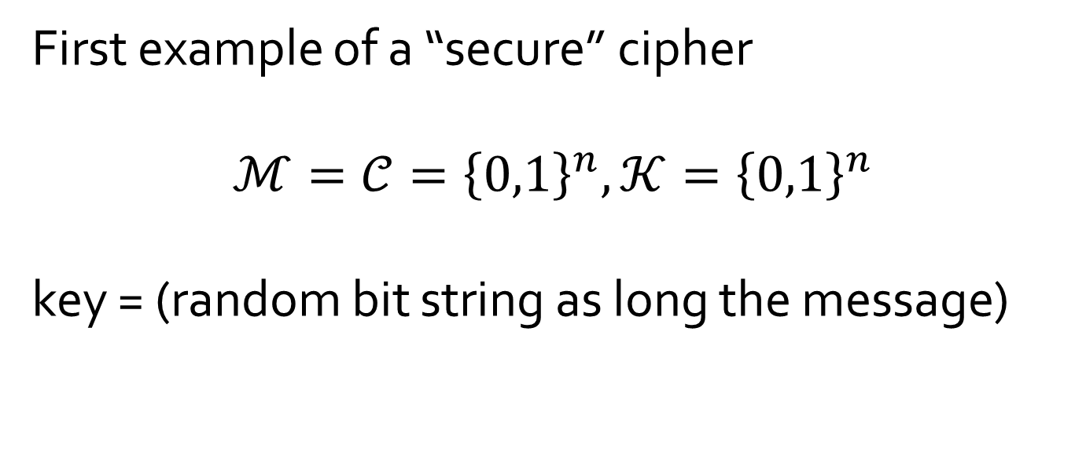
The One Time Pad (Vernam 1917)
First example of a “secure” cipher
$$ℳ=𝒞={\left\{0,1\right\}}^{n},𝒦={\left\{0,1\right\}}^{n}$$
key = (random bit string as long the message)
Notes:
Define CT, PT, and key spaces

Slide 6

The One Time Pad (Vernam 1917)
$\begin{matrix}c & = & E\left(k,m\right) \\ & = & K⨁m \end{matrix}$
$D\left(K,c\right)=K⨁c$
Indeed, $\begin{matrix}D\left(K,E\left(K,m\right)\right) & = & D\left(K,K⨁m\right) \\ & = & K⨁\left(K⨁m\right) \\ & = & \left(K⨁K\right)⨁m \\ & = & m\end{matrix}$
msg: 0 1 1 0 1 1 1
key: 1 0 1 1 0 1 0
CT:
⊕
Notes:
Define OTP operation: equation and example. Verify correctness.

Slide 7
The One Time Pad (Vernam 1917)
Very fast enc/dec !!
… but long keys (as long as plaintext)
Is the OTP secure? What is a secure cipher?

Slide 8
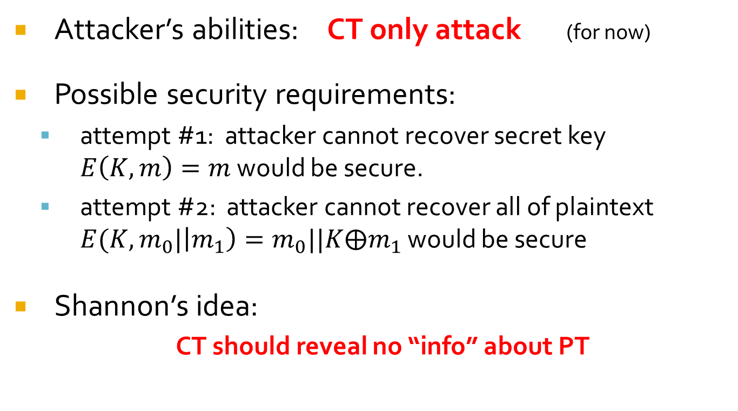
What is a secure cipher?
Attacker’s abilities: CT only attack (for now)
Possible security requirements:
attempt #1: attacker cannot recover secret key $E\left(K,m\right)=m$ would be secure.
attempt #2: attacker cannot recover all of plaintext $E(K,m_{0}|\left|m_{1}\right)=m_{0}||K⨁m_{1}$ would be secure
Shannon’s idea:
CT should reveal no “info” about PT

Slide 9
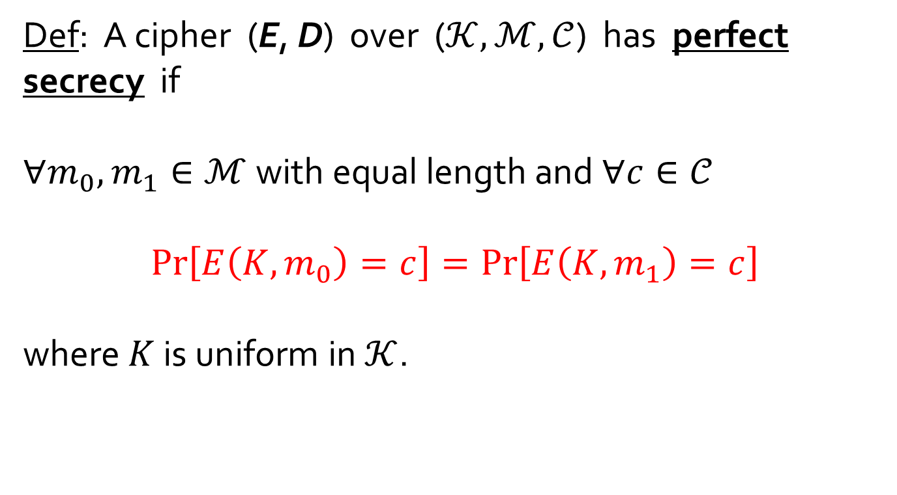
Information Theoretic Security (Shannon 1949)
Def: A cipher (E, D) over ($𝒦, ℳ, 𝒞$) has perfect secrecy if
$∀m_{0},m_{1}∈ℳ$ with equal length and $∀c∈𝒞$
$$\operatorname{Pr}\left[E\left(K,m_{0}\right)=c\right]=\operatorname{Pr}\left[E\left(K,m_{1}\right)=c\right]$$
where $K$ is uniform in $𝒦$.

Slide 10
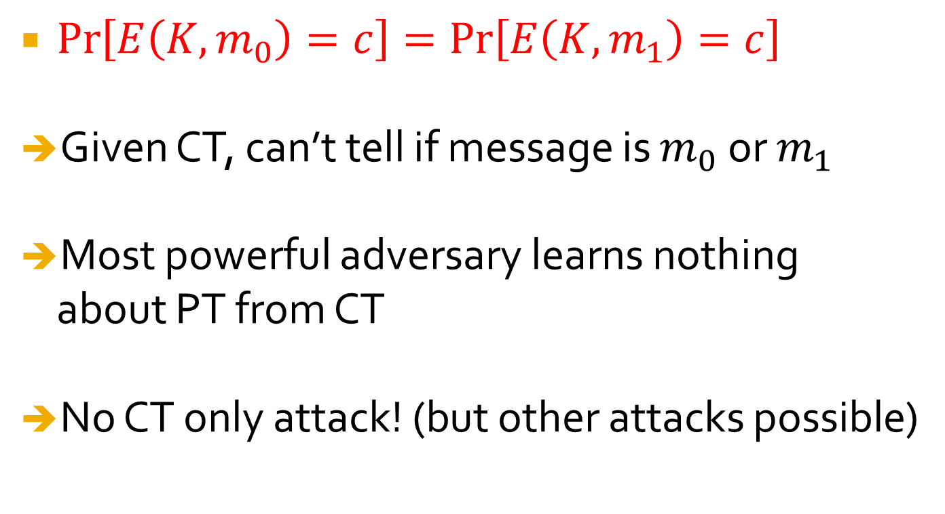
Implications
$\operatorname{Pr}\left[E\left(K,m_{0}\right)=c\right]=\operatorname{Pr}\left[E\left(K,m_{1}\right)=c\right]$
Given CT, can’t tell if message is $m_{0}$ or $m_{1}$
Most powerful adversary learns nothing about PT from CT
No CT only attack! (but other attacks possible)
Notes:
Explain impications

Slide 11
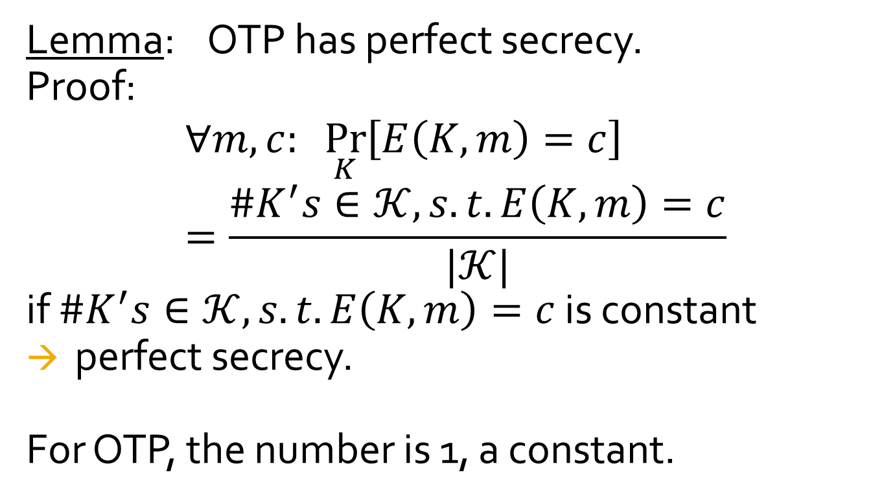
Lemma: OTP has perfect secrecy.
Proof:
$$∀m,c: \underset{K}{Pr}\left[E\left(K,m\right)=c\right]=\frac{\#K^{′}s∈𝒦,s.t. E\left(K,m\right)=c}{|𝒦|}$$
if $\#K^{′}s∈𝒦,s.t. E\left(K,m\right)=c$ is constant
perfect secrecy.
For OTP, the number is 1, a constant.

Slide 12
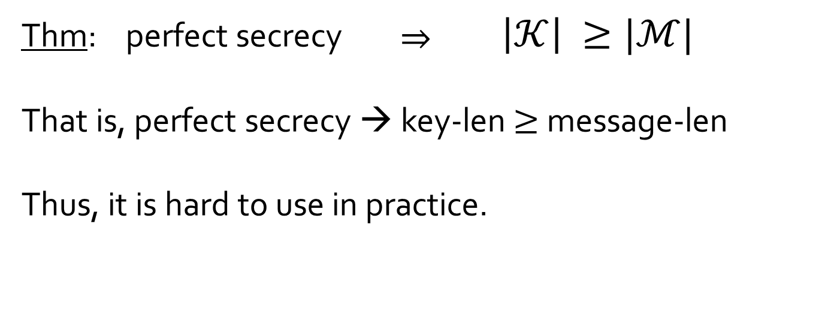
The bad news …
Thm: perfect secrecy ⇒ $\left|𝒦\right| ≥|ℳ|$
That is, perfect secrecy → key-len $≥$ message-len
Thus, it is hard to use in practice.

Slide 13
Semantic Security (one-time key)
For b=0,1 define experiments EXP(0) and EXP(1) as:
for b=0,1: W_{b} := [ event that EXP(b)=1 ] Adv_{SS}[A,E] := | Pr[ W₀ ] − Pr[ W₁ ] | ∈ [0,1]
b
Chal.
m₀ , m₁ ∈ M : |m₀| = |m₁|
Adv. A
k←K
c ← E(k, m_{b})
b’ ∈ {0,1}

Slide 14
Semantic Security (one-time key)
Def: E is semantically secure if for all efficient A Adv_{SS}[A,E] is negligible.
⇒ for all explicit m₀ , m₁ ∈ M : { E(k,m₀) } ≈_{p} { E(k,m₁) }

Slide 15
OTP is semantically secure
EXP(0):
Chal.
m₀ , m₁ ∈ M : |m₀| = |m₁|
Adv. A
k←K
c ← k⊕m₀
b’ ∈ {0,1}
identical distributions
Chal.
m₀ , m₁ ∈ M : |m₀| = |m₁|
Adv. A
EXP(1):
k←K
c ← k⊕m₁
b’ ∈ {0,1}
For all A: Adv_{SS}[A,OTP] = | Pr[ A(k⊕m₀)=1 ] − Pr[ A(k⊕m₁)=1 ] |= 0

Slide 16
Pseudorandom Generators

Slide 17
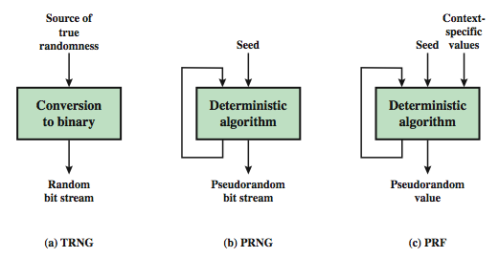
Random & Pseudorandom Number Generators
Notes:
Stallings Figure 7.1 contrasts a true random number generator (TRNG) with two forms of pseudorandom number generators. A TRNG takes as input a source that is effectively random; the source is often referred to as an entropy source. In contrast, a PRNG takes as input a fixed value, called the seed, and produces a sequence of output bits using a deterministic algorithm. Typically, as shown, there is some feedback path by which some of the results of the algorithm are fed back as input as additional output bits are produced. The important thing to note is that the output bit stream is determined solely by the input value or values, so that an adversary who knows the algorithm and the seed can reproduce the entire bit stream.
Figure 7.1 shows two different forms of PRNGs, based on application;
• Pseudorandom number generator: An algorithm that is used to produce an open-ended sequence of bits is referred to as a PRNG. A common application for an open-ended sequence of bits is as input to a symmetric stream cipher, as discussed in Section 7.4. Also, see Figure 3.1a.
• Pseudorandom function (PRF): A PRF is used to produced a pseudorandom string of bits of some fixed length. Examples are the symmetric encryption keys and nonces. Typically, the PRF takes as input a seed plus some context specific values, such as a user ID or an application ID.

Slide 18
PRNG Requirements
randomness
uniformity, scalability, consistency
unpredictability
forward & backward unpredictability
use same tests to check
characteristics of the seed
secure
if known adversary can determine output
so must be random or pseudorandom number
Notes:
When a PRNG or PRF is used for a cryptographic application, then the basic requirement is that an adversary who does not know the seed is unable to determine the pseudorandom string. This general requirement for secrecy of the output of a PRNG or PRF leads to specific requirements in the areas of randomness, unpredictability, and the characteristics of the seed.
In terms of randomness, the requirement for a PRNG is that the generated bit stream appear random even though it is deterministic. NIST SP 800-22 (A Statistical Test Suite for Random and Pseudorandom Number Generators for Cryptographic Applications) specifies that the tests should seek to establish the following three characteristics: uniformity, scalability, consistency. SP 800-22 lists 15 separate tests of randomness.
A stream of pseudorandom numbers should exhibit two forms of unpredictability: forward unpredictability, backward unpredictability. The same set of tests for randomness also provide a test of unpredictability. If the generated bit stream appears random, then it is not possible to predict some bit or bit sequence from knowledge of any previous bits. Similarly, if the bit sequence appears random, then there is no feasible way to deduce the seed based on the bit sequence. That is, a random sequence will have no correlation with a fixed value (the seed).
For cryptographic applications, the seed that serves as input to the PRNG must be secure. Because the PRNG is a deterministic algorithm, if the adversary can deduce the seed, then the output can also be determined. Therefore, the seed must be unpredictable. In fact, the seed itself must be a random or pseudorandom number.

Slide 19

Stream Ciphers: making OTP practical
idea: replace “random” key by “pseudorandom” key
PRG is a deterministic and efficiently computable function $G:{\left\{0,1\right\}}^{s}→{\left\{0,1\right\}}^{n}$ such that $n≫s$
seed space
Notes:
State PRG syntax

Slide 20

Stream Ciphers: making OTP practical
$c=E\left(K,m\right)=m⨁G\left(K\right)$
$D\left(K,c\right)=c⨁G(K)$
Notes:
Define stream cipher

Slide 21
Can a stream cipher have perfect secrecy?
Yes, if the PRG is really “secure”
No, there are no ciphers with perfect secrecy
Yes, every cipher has perfect secrecy
No, since the key is shorter than the message

Slide 22
Stream Ciphers: making OTP practical
Stream ciphers cannot have perfect secrecy !!
Need a different definition of security
Security will depend on specific PRG
Notes:
No more perfect secrecy

Slide 23
PRG must be unpredictable
Notes:
Define unpredictability

Slide 24
PRG must be unpredictable
We say that G: K ⟶ {0,1}^{n} is predictable if:
Def: PRG is unpredictable if it is not predictable
⇒ ∀i: no “efficient” adversary can predict bit (i+1) for “non-negligible probability.

Slide 25

Weak PRGs (do not use for crypto)
Linear congruence generator with parameters $a,b,p$
$r\left[i\right]←a×r\left[i−1\right]+b mod p$
Output bits of $r\left[i\right]$
$i$++
seed is $r[0]$
glibc random():
r[i] ← ( r[i-3] + r[i-31] ) % 2³²
output r[i] >> 1
Notes:
LCG is not secure

Slide 26
One Popular Stream Cipher

Slide 27
RC4
a proprietary cipher owned by RSA DSI
variable key size, byte-oriented stream cipher
widely used (web SSL/TLS, wireless WEP/WPA)
key forms random permutation of all 8-bit values
uses that permutation to scramble input info processed a byte at a time
Notes:
RC4 is a stream cipher designed in 1987 by Ron Rivest for RSA Security. It is a variable key-size stream cipher with byte-oriented operations. The algorithm is based on the use of a random permutation. Analysis shows that the period of the cipher is overwhelmingly likely to be greater than 10^100. Eight to sixteen machine operations are required per output byte, and the cipher can be expected to run very quickly in software. RC4 is probably the most widely used stream cipher. It is used in the SSL/TLS secure web protocol, & in the WEP & WPA wireless LAN security protocols. RC4 was kept as a trade secret by RSA Security, but in September 1994 was anonymously posted on the Internet on the Cypherpunks anonymous remailers list. In brief, the RC4 key is ued to form a random permutation of all 8-bit values, it then uses that permutation to scramble input info processed a byte at a time.

Slide 28
RC4 Key Schedule
starts with an array S of numbers: 0..255
use key to well and truly shuffle
S forms internal state of the cipher
for i = 0 to 255 do
S[i] = i
T[i] = K[i mod keylen])
j = 0
for i = 0 to 255 do
j = (j + S[i] + T[i]) (mod 256)
swap (S[i], S[j])
Notes:
The RC4 algorithm is remarkably simple and quite easy to explain. It uses a variable-length key of from 1 to 256 bytes. The RC4 key schedule initialises the state S to the numbers 0..255, and then walks through each entry in turn, using its current value plus the next byte of key to pick another entry in the array, and swaps their values over. After doing this 256 times, the result is a well and truly shuffled array. The total number of possible states is 256! - a truly enormous number, much larger even than the 2048-bit (256*8) max key allowed can select.

Slide 29
RC4 Encryption
encryption continues shuffling array values
sum of shuffled pair selects "stream key" value from permutation
XOR S[t] with next byte of message to en/decrypt
i = j = 0
for each message byte M_{i}
i = (i + 1) (mod 256)
j = (j + S[i]) (mod 256)
swap(S[i], S[j])
t = (S[i] + S[j]) (mod 256)
C_{i} = M_{i} XOR S[t]
Notes:
To form the stream key for en/decryption (which are identical), RC4 continues to shuffle the permutation array S by continuing to swap each element in turn with some other entry, and using the sum of these two entry values to select another value from the permutation to use as the stream key, which is then XOR’d with the current message byte.

Slide 30
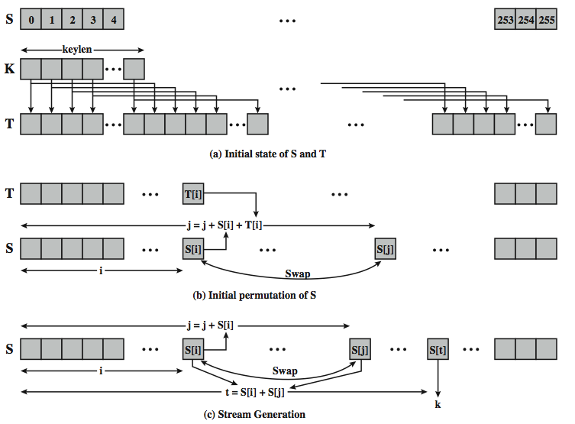
Notes:
Stallings Figure 7.6 illustrates the general structure of RC4.

Slide 31
RC4 Security
claimed secure against known attacks
have some analyses, none practical
result is very non-linear
since RC4 is a stream cipher, must never reuse a key
Notes:
A number of papers have been published analyzing methods of attacking RC4, but none of these approaches is practical against RC4 with a reasonable key length, such as 128 bits.
A more serious problem occurs in its use in the WEP protocol, not with RC4 itself but the way in which keys are generated for use as input to RC4.
Currently RC4 its regarded as quite secure, if used correctly, with a sufficiently large key.

Slide 32
Attacks on OTP and stream ciphers

Slide 33
Attack 1: two time pad is insecure !!
Never use stream cipher key more than once !!
C₁ ← m₁ ⊕ PRG(k)
C₂ ← m₂ ⊕ PRG(k)
Eavesdropper does:
C₁ ⊕ C₂ → m₁ ⊕ m₂
Enough redundancy in English and ASCII encoding that: m₁ ⊕ m₂ → m₁ , m₂

Slide 34

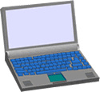
Real world examples
Project Venona
MS-PPTP (windows NT):
k
k
Need different keys for C⟶S and S⟶C
Notes:
Venona: soviet messages sent from 1941 to 1946, decrypted about 3000 messages.

Slide 35

Real world examples
802.11b WEP:
Length of IV: 24 bits
Repeated IV after 2²⁴ ≈ 16M frames
On some 802.11 cards: IV resets to 0 after power cycle
m
CRC(m)
k
PRG( IV ll k )
k
IV
ciphetext

Slide 36
Avoid related keys
802.11b WEP:
key for frame #1: (1 ll k)
key for frame #2: (2 ll k)
m
CRC(m)
k
PRG( IV ll k )
k
IV
ciphetext
⋮

Slide 37
A better construction
k
PRG
k
⇒ now each frame has a pseudorandom key
better solution: use stronger encryption method (as in WPA2)

Slide 38
Two time pad: summary
Never use stream cipher key more than once !!
Network traffic: negotiate new key for every session (e.g. TLS)
Disk encryption: typically do not use a stream cipher

Slide 39
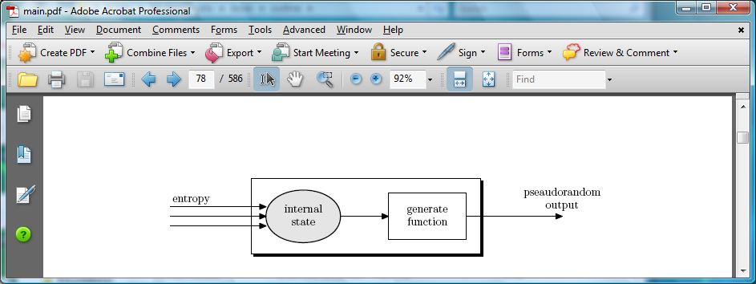
Generating Randomness (e.g. keys, IV)
Pseudo random generators in practice: (e.g. /dev/random)
Continuously add entropy to internal state
Entropy sources:
Hardware RNG: Intel RdRand inst. (Ivy Bridge). 3Gb/sec.
Timing: hardware interrupts (keyboard, mouse)
NIST SP 800-90: NIST approved generators

Slide 40
Natural Random Noise
best source is natural randomness in real world
find a regular but random event and monitor
do generally need special h/w to do this
eg. radiation counters, radio noise, audio noise, thermal noise in diodes, leaky capacitors, mercury discharge tubes etc
starting to see such h/w in new CPU's
problems of bias or uneven distribution in signal
have to compensate for this when sample, often by passing bits through a hash function
best to only use a few noisiest bits from each sample
RFC4086 recommends using multiple sources + hash
Notes:
A true random number generator (TRNG) uses a nondeterministic source to produce randomness. Most operate by measuring unpredictable natural processes, such as pulse detectors of ionizing radiation events, gas discharge tubes, and leaky capacitors. Special hardware is usually needed for this. A true random number generator may produce an output that is biased in some way. Various methods of modifying a bit stream to reduce or eliminate the bias have been developed. These are referred to as deskewing algorithms. One approach to deskew is to pass the bit stream through a hash function such as MD5 or SHA-1. RFC 4086 recommends collecting input from multiple hardware sources and then mixing these using a hash function to produce random output.

Slide 41
Take-home Information
Information theoretic security
Semantic security
PRG and stream ciphers
RC4
Notes:
Chapter 7 summary.

